Slide 1
Development of Rectal Tonometer for Diagnosis of Occult Tethered Cord Syndrome (TCS)
PI: Eniko Enikov, Professor Aerospace and Mechanical Engineering, Bio5, UA
Co-PIs: Richard Chua, Professor of Neurosurgery, Banner UMC, UA
Anthony Avellino, MD, Professor of Pediatric Neurosurgery, Banner UMC, UA
Rein Anton, MD Neurosurgery CNS, PhD Biochemistry, Banner UMC, UA
Title Slide

Slide 2
Clinical need and scale of the problem
Tethered Cord Syndrome (TCS) is a spectrum of congenital anomalies characterized by neurological, gastrointestinal, musculoskeletal, and urinary disfunction. TCS has an incidence rate of 0.25 per 1,000 births affecting 1000 children in US every year.
TCS is believed to occur as a result of spinal cord traction within the spinal canal.
Causes of tethering can be acquired (secondary) or congenital (primary). Most often TCS is associated with spina bifida, a congenital condition frequently discovered at birth. Other causes of TCS are spinal cord tumor, myelomeningocele, and an elongated cord.
In the absence of proper surgical treatment, TCS leads to neurologic, orthopedic, and urologic symptoms which could worsen leading to life-long disability.
In some cases, patients with TCS have normal imaging studies (MRI), a condition known as Occult TCS (OTCS).
Diagnosis of Occult TCS is difficult and controversial. By the time symptoms of OTCS are apparent, irreversible damage has occurred.
Early detection of OTCS is essential for its timely treatment and reduction of its morbidity.
Incumbent methods of diagnosis of OTCS are very invasive and involve inflation of the bladder, until a contractile reflex is induced. This is particularly difficult to do in children.
Besides OCTS, rectal tonometry could be used in detection of Cauda Equina Syndrome (CES) in trauma patients, and in detection of anal sphincter injury during birth. The later presents a much larger market opportunity, that could support the development of a commercial product.

Slide 3
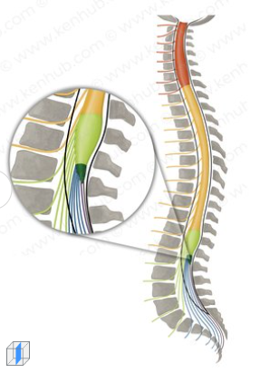
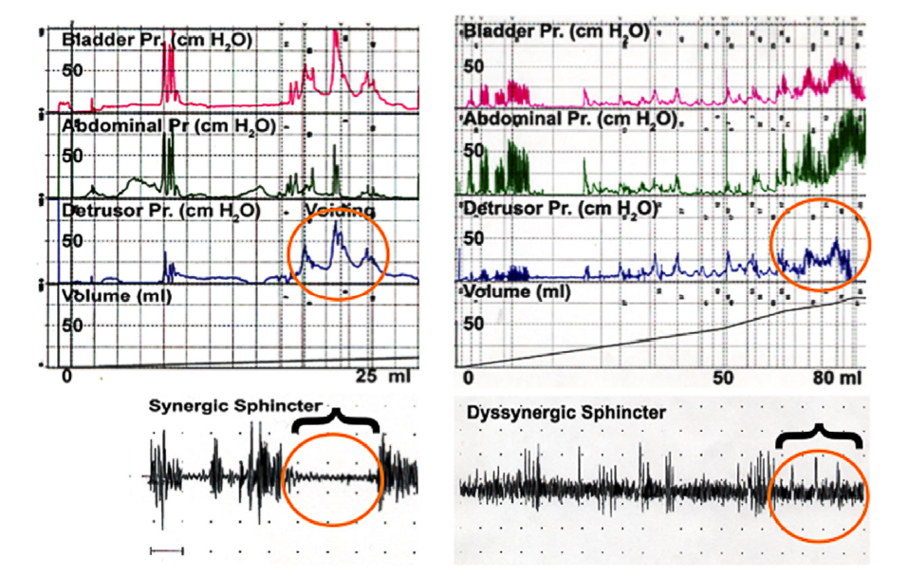
Current clinical solutions and their limitations
During normal growth, the spinal cord ascends within the canal and its conus medullaris (tail end) moves from level L4 to L2 between birth and puberty.
In Occult TCS, conus medullaris is at its normal position, yet children develop a variety of symptoms around age 6 to 12 yrs including difficulty walking; back pain, progressive foot deformity, scoliosis, and deterioration of bladder and bowel function.
Current methods for diagnosing OTCS are based on clinical symptoms, often resulting in delayed diagnosis and treatment.
Most common in OTCS is urinary dysfunction, which has resulted in invasive urodynamic diagnostic studies.
Urodynamic studies involve urethral catheterization; and the placement of a rectal catheter to measure abdominal pressure and often needle electrodes for sphincter EMG. Studies involve inflation of bladder until a reflexory response is measured (see graph on the right).
Such studies are difficult and risky in children, hence diagnosis of OTCS is often delayed or unnecessary surgeries are undertaken.
Conus Medullaris
Urodynamic
Studies

Slide 4
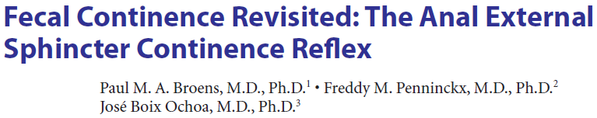
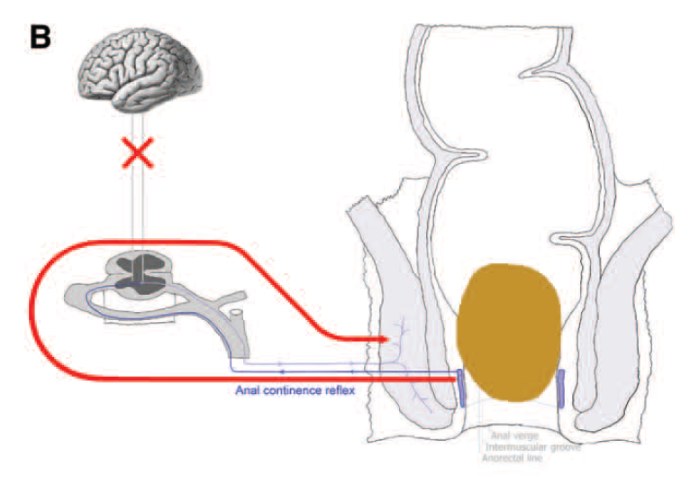
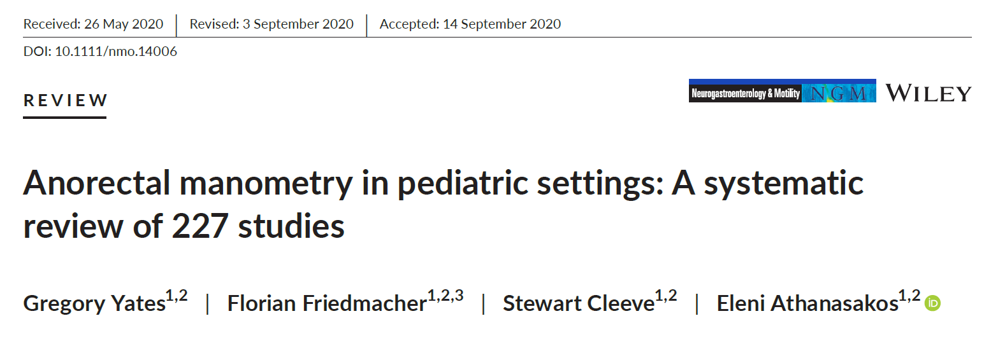
Proposed new solution and expected benefits
Rectal tone has been established as an alternative, less invasive method for testing the integrity of sacral nerves (see first paper on the right).
Studies have shown correlation between bladder and rectal response in patients with OTCS, thus indicating that a less-invasive rectal testing could be used (see review paper).
Using rectal tone (pressure response of the inner and outer sphincters) has been accepted for screening of Cauda Equina Syndrome, damage of the sacral nerves below the conus medullaris due to trauma or tumors.
Currently anorectal manometry utilizes expensive machines, while rectal tone in trauma centers is still measured subjectively using a finger (digital) rectal exam, due to the large cost of these systems.
Out team has developed a prototype of instrumented ano-rectal tonometer, capable of reporting dynamic changes in the rectal tone.
Dynamic pressure pulses (reflexory response) can be induced through stimulation of the external sphincter by the instrument itself, (see figure on this slide.
The form factor of the device is suppository-like, hence more acceptable by patients and doctors.
Continence Reflex to be used in testing of OTCS

Slide 5
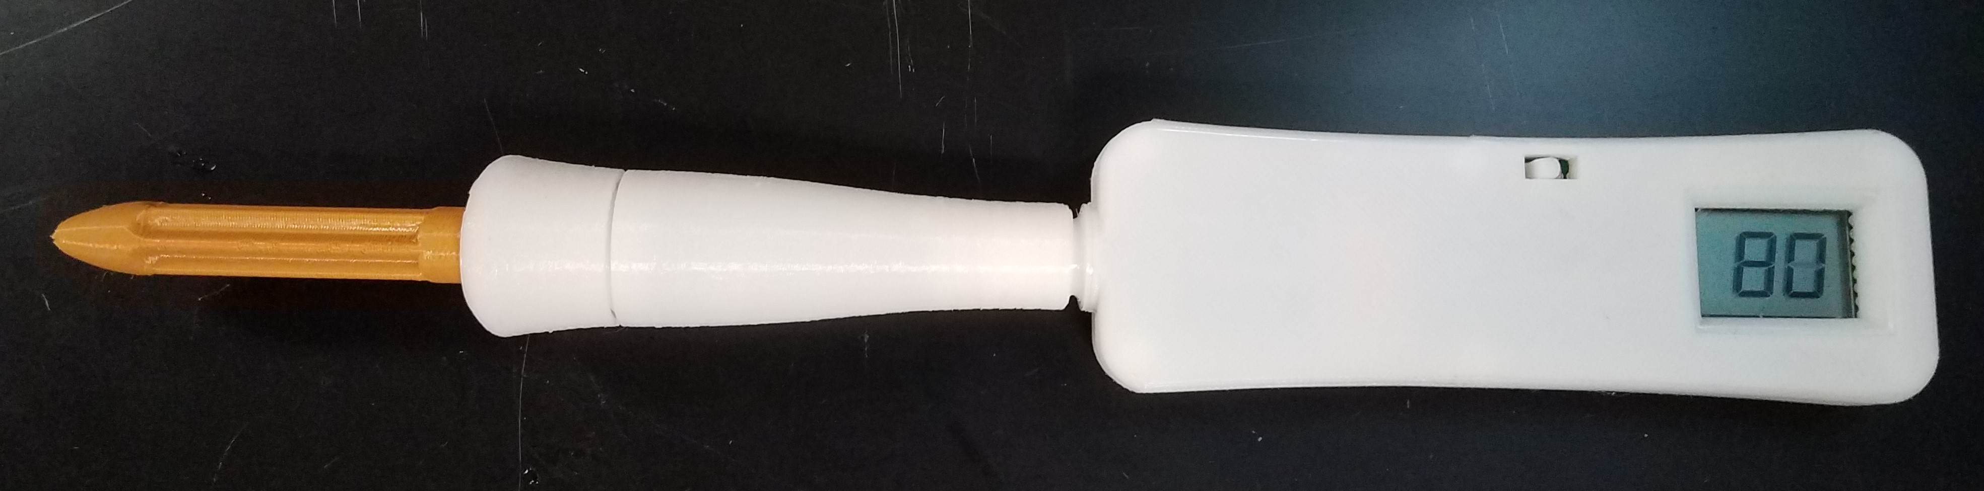
Development work done to-date (1 of 2 slides)
An adult version of the tonometer has been developed by an NSF training grant NEU 1446048
First protype was tested/calibrated using pneumatic cuff.
As a stand-alone unit it displayed actual pressure without record generation.
Design contained Disposable Piece (Tip) and a Permanent Piece (electronic interface.)
Low-volume production costs for each piece were established
https://nsf.gov/awardsearch/showAward?AWD_ID=1446098

Slide 6
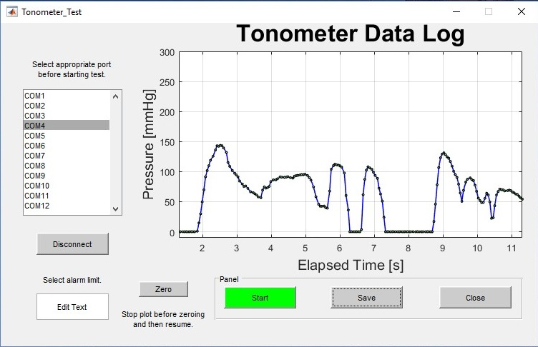
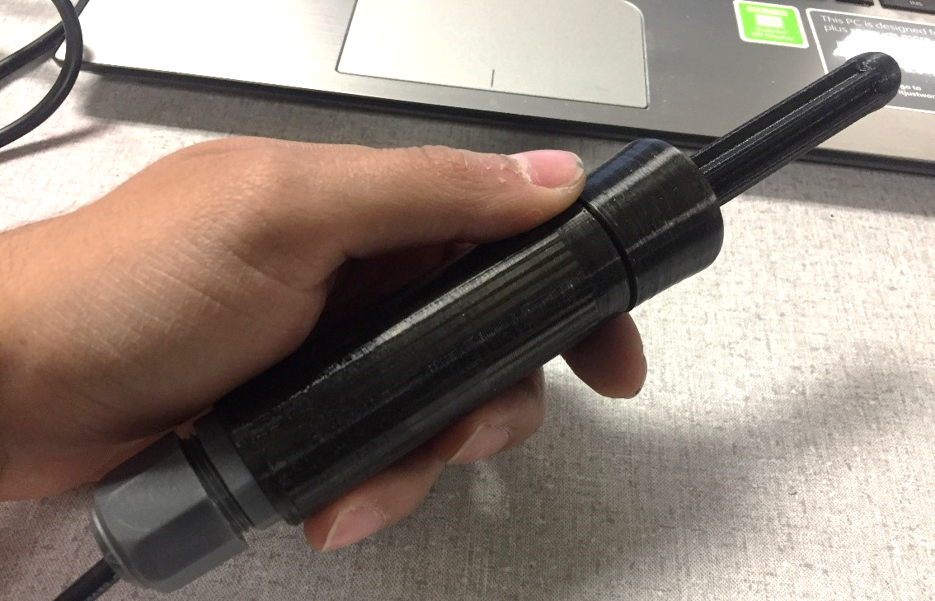
Development work done to-date (2 of 2 slides)
A second-generation device capable of recording dynamic tone was created in 2019 (before COVID)
The device uses USB interface to a computer recording the rectal tone in real-time.
Developed design for new device with expandable tip to replace balloon inflation.
Due to COVID, it was not possible to collect human subject data with this device (except of inventor’s self-testing).

Slide 7
Validation
The technology has been presented to three neurosurgeons: Dr Richard Chua (Banner UMC), Dr Antony Avellino (Banner UMC), and Dr. Jesse Skoch (Cincinnati Children’s Hospital).
Dr Avellino proposed its use in diagnosis of Occult Tethered Cord Syndrome
Dr Chua proposed its use in spinal stenosis patients as an indicator for post-surgical recovery and successful surgical intervention
All three surgeons found the proposed approach viable and useful. Below is an excerpt from a letter of support from Dr Skoch:
… Diagnosis of Occult Tethered Cord Syndrome (OTCS) is based on clinical symptoms and invasive urodynamic studies. Timely diagnosis of OTCS could spare as many as 1000 children every year from a life-long disability resulting from missed diagnosis. The proposed rectal tonometer holds the promise of producing a quantitative measure of reduced rectal tone, which could aid in the diagnosis of OTCS …
Jesse Skoch, MD,
Faculty Neurosurgeon, Division of Pediatric Neurosurgery
Assistant Professor, UC Department of Neurosurgery
jesse.skoch@cchmc.org
513-636-4726

Slide 8
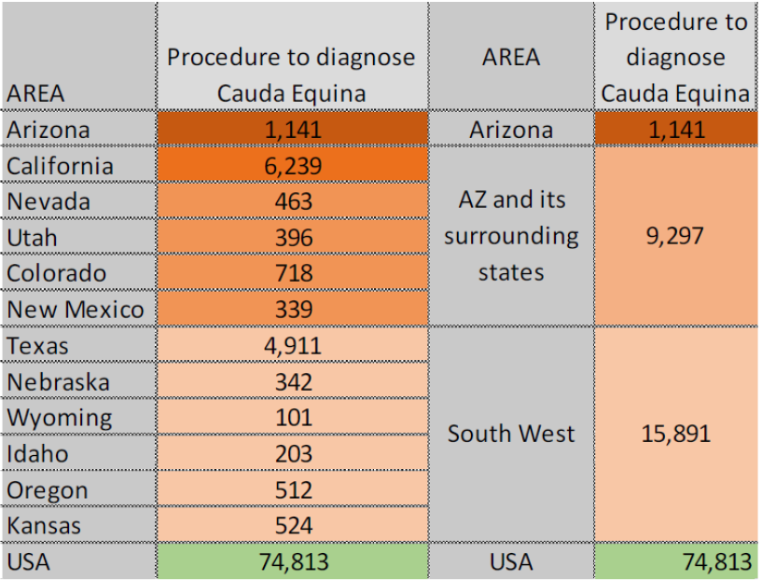
Plan - commercialization/licensing
Estimated volume of annual US sales associated with Cauda Equina diagnosis.
The following analysis was carried out for Cauda Equina Syndrome related sales. Similar markets exists for TCS.
Clinical application of the proposed rectal tonometers (adult and pediatric) are all patients with acute lower back pain, spinal cord injuries, children with urinary or fecal incontinence, pregnant women with lumbar disk herniation. Additional potential stakeholders are medical malpractice insurance companies paying for missed diagnosis of Cauda Equina Syndrome and TCS. The average payout to claimants with missed CES diagnosis is $459k.
Our plan for capturing customers builds on estimates of number of annual digital rectal exams in Arizona, surrounding states, Western US, and US data (see Table).
Since there isn’t a competing device, the capture of this market is projected over 10 years: Years 1-2 Arizona; Years 3-4 Surrounding states; Years 5-6 Western US, and 7-10 US. Using a estimated sale price of $200, we anticipate 15M in sales and operating costs of 4M, resulting in valuation of approximately 11M.
The required fundraising is estimated at 300k (series A) and 400k (series B), representing 60% if investor ownership, hence a 10-year investor return is estimated at 940%.

Slide 9
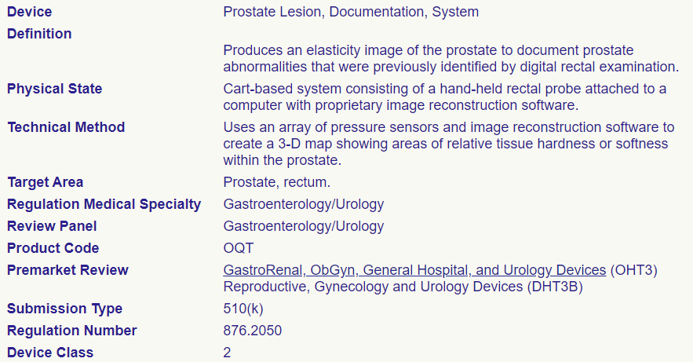
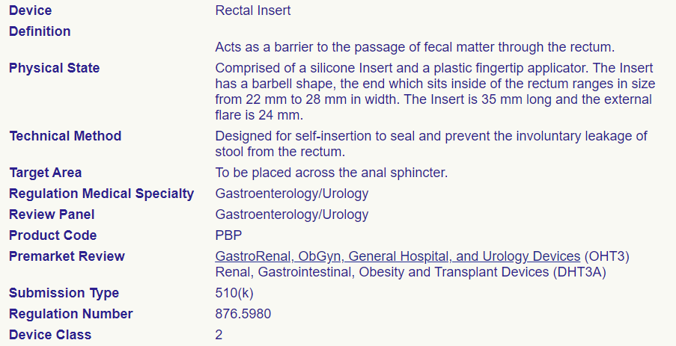
Regulatory requirements and plan to address
Rectal tonomer is likely to be categorized as Class II device by FDA.
The regulatory requirements will require submission of pre-market notification for securing a 510k clearance from FDA.
Several predicate devices exist in the FDA database, including
Rectal Insert (passive device) Reg. 876.5980
Prostate Lesion Documentation System hand-held probe measuring elasticity of prostate through the rectum Reg. 876.2050.
Because these predicates have different clinical use, it may be required to request investigational device exemption (IDE) to collect clinical data indicating ability to discern neurological deficit.
Under this grant, we plan to prepare and file a Q-sub to FDA describing the tonomter’s proposed indication. The Q-sub will provide feedback on the requirements and scope of the IDE request.
Depending on the review turnaround response time to the Q-sub program, it is anticipated that an IDE will also be filed with FDA during the 18-month duration of this grant.
Predicate
Devices:

Slide 10
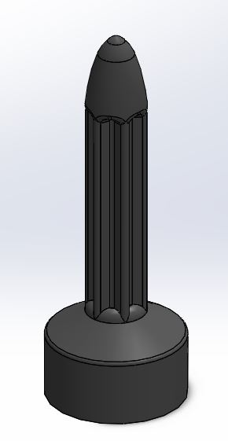
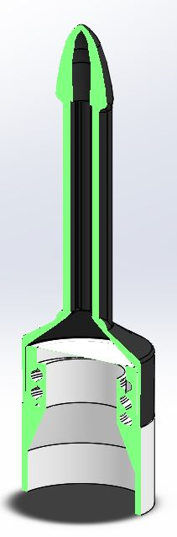
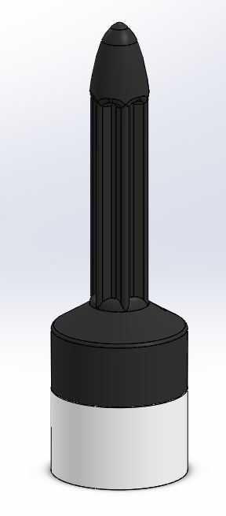
Project plan for grant period
The primary objective of the proposed project plan is to demonstrate clinical relevance of the rectal tonometer. To this end we will:
Secure an IRB approval to measure rectal tone in 30 subjects undergoing spinal stenosis treatment (surgeries ) by co-PI Dr Richard Chua, Banner UMC.
Pre- and post-operative rectal tone will be measured approximately 5 weeks apart using the existing adult rectal tonometer.
Resting tone, and squeeze pressure and its relaxation will be recorded.
It is hypothesized that rectal tone will be diminished prior to surgery and will recover post-operatively, indicating a successful relieve of spinal stenosis.
These data will be used in the development of next-generation pediatric device containing a detachable tip (see figures.)
The inflatable pediatric device will be tested during gradual retraction for presence of anal external sphincter continence reflex.
The presence/absence of such reflex occult tethered cord syndrome will be analyzed by co-PI Anthony Avellino in pediatric patients. This study will require a second IRB for pediatric use.
Proposed Next-Generation Pediatric Tonometer with
Single-Use Detachable Tip
Detachable Single-Use
Tip

Slide 11
Current intellectual property (IP) and IP strategy
An initial disclosure to the University of Arizona IP office ( Tech Launch Arizona, TLA) has been filed in 2017 under UA17-202
TLA has filed a provisional patent application with USPTO under reference UNIA 21.27 PROV on Dec 15, 2022
The IP covers the current design and the components of the current system.
TLA will file a utility application before Dec 15,2023 with additional claims based on the proposed work in this proposal.
A licensing plan and a creation of a start-up company has been pre-approved by the director of TLA, Douglas M Hockstad in January 2022.

Slide 12
Funding received to date and future funding strategy
Initial concept was created in 2017 through an NSF educational grant focused on micro-sensors NSF https://nsf.gov/awardsearch/showAward?AWD_ID=1446098. This grant provided a total of $200k to the University of Arizona to organize student training in biomedical nanotechnology. The prototype of the tonometer was produced through this grant along with other training activities.
During COVID 19 epidemic, the planned human subject tests could not be carried out.
If funded, this application will expand the application of rectal tonometry to pediatric population for diagnosis of Occult Tethered Cord Syndrome.
Concurrently, we are seeking NSF PFI funding. NSF does not support human subject testing and clinical studies, however their PFI program offers business and customer discovery activities and can fund junior innovator (graduating PhD student or Postdoc) and resources to further perfect and de-risk the proposed technology.
As part of our funding strategy, through our partners (Toker and Smallhouse), we will make pitch presentations to the local angle investor community – Desert Angles (Tucson); Canyon Angels (Phoenix), Arris Ventures (Phoenix) and others.

Slide 13
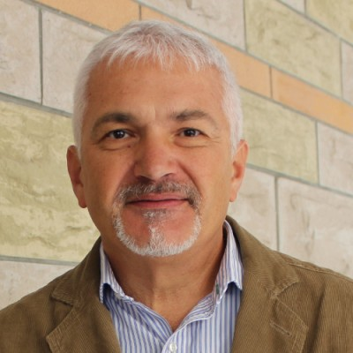

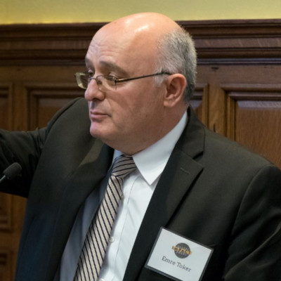

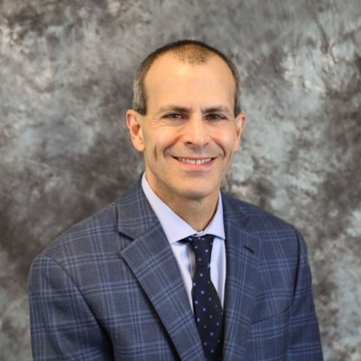
Project Team/Resources and Environment
Inventors and developers:
Eniko Enikov, PhD UA College of Engineering
https://www.linkedin.com/in/eniko-enikov-618b8b106/
Rein Anton, MD, PhD Neurosurgery
https://medicine.arizona.edu/person/rein-anton-md-phd
Business partners (Arch Partners Venture Group)
Medical Consultants
Dr Richard Chua, Banner UMC specializing in spinal stenosis surgeries
https://www.linkedin.com/in/richard-v-chua-md-faans-facs-051b7940/
Dr. Anthony Avellino, Banner UMC specializing in pediatric neurosurgery with interests in Occult Tethered Cord Syndrome
https://www.linkedin.com/in/anthony-m-avellino-m-d-m-b-a-aa52a536/
Emre Toker from Arch Partners Venture Group
https://www.linkedin.com/in/emre-toker/
https://archpartnersllc.com/the-partners

