Slide 1


Nature’s Answer. Every Extra Day Counts.
• Extend shelf-life • 100% GRAS plant-based ingredients • Edible • Eco-friendly

Slide 2
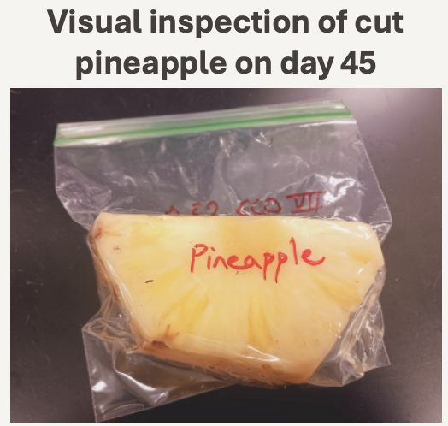
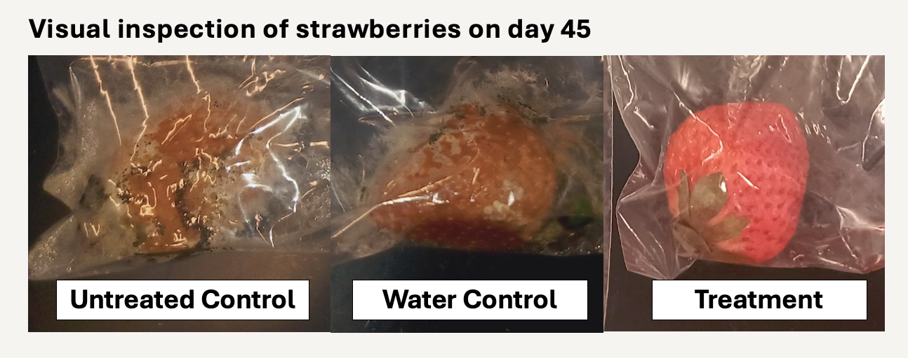
From food safety to extended freshness
Focus on extension of shelf-life
Immediate cost-savings; easier to demonstrate ROI
Even a few days can save millions in retail chains
Reduced spoilage and less food waste
Longer sell-by dates
Flexible logistics
Extended distribution range
Lower return rates from retailers
Premium pricing potential

Slide 3
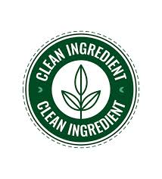
From food safety to extended freshness
Focus on extension of shelf-life
Less Regulation and Liability Risk
Antimicrobial claims on pathogens have stringent FDA/EPA scrutiny
Higher market entry barrier
Fewer competition, less crowded innovation space
Some competition but none for fresh-cut fruit to extend to 30-45 days
Clean label/Natural a strong fit with trends regarding shelf- life
In food safety, harder to replace chemicals for pathogen control
Faster go-to-market potential
“Extended shelf-life” much easier to market than “kill pathogens” claims
Openness to trials to reduce waste vs. risk adverse
Aligns with food security and environmental sustainability goals

Slide 4
Addressable Markets - Fresh Strawberries
Global fresh strawberry market: ~ $16 - 21B (global TAM)
U.S. fresh strawberry market value: ~$4 - 6B annually (TAM)
Waste reduction potential: 30% of $4B suggests $1.2B spoilage loss addressable market; if conservative 50% recoverable ~ $600M
Strawberry waste reduction market is more than N. America agriculture sanitizer market ($563M)
Serviceable obtainable market, if capture 5% of $600M over 5 years = $30M/yr potential
BioSafe Systems LLC Revenue: $18.6M (PAA); Smartwash Revenue: $8.6M (chlorine with acid reducer)
Additional revenue from premium pricing or licensing
CAGR est. 3.2 – 6.4%
Notes:
BioSafe Systems LLC Revenue: $18.6M (PAA); Smartwash Revenue: $8.6M (chlorine with acid reducer)

Slide 5
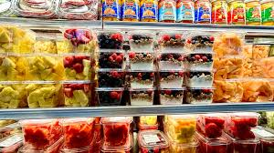
Addressable Markets – Fresh-Cut Fruit
U.S. fresh-cut fruit market: ~ $15 - 20B
U.S. fresh-cut apple market value: ~$3 – 6B annually (TAM)
20-30% of market
U.S. fresh-cut pineapple market value: ~$1.5 - 3B annually (TAM)
5-10% of market
E.g. for fresh-cut pineapple
Serviceable Obtainable Market, if capture 5% of $1.5B over 5 years = $75M
Not accounting for expanded demand
Shelf-life of 30 – 45 days would increase TAM
Waste reduction, expanded distribution, increased demand
E.g. for fresh-cut pineapple, 30% increase is ~ $500M - $1B

Slide 6
Table of main competitors
 | Apeel Sciences | Safe Foods Corporation
Founded | 2012 | 1999
Core Tech | Lipids from seeds, peels, pulp as a physical barrier | Chemical based (mainly lauric arginate) as anti-microbial
 | Reduces food waste – produce – avocados, citrus (oranges, limes, lemons, grapefruit) | Control foodborne pathogens - meat, poultry, seafood, produce
 | Plant based, GRAS, biomimicry Preserve freshness with 2nd skin | Also design systems – spray, dip, water recycling, dosing
Customers | Retailers, growers | Food processors, slaughterhouses
Financial Valuation | Est. ~$2B (2021 Series E funding) | Est. $100 – 200M (private)
Funding | >$640M total Started with $100K from Gates Foundation, raised ~$1.25M seed round (2013), then Series A-E | Private ownership, stable B2B food safety, moderate niche market
Revenue | Est. $20 - 50M+ | Est. $30 – 50M

Slide 7
Valuation Drivers for PCS
Extension of up to 45 days depending on commodity and treatment
GRAS-based, no synthetic additives
Every ingredient is permitted under the NOP program
Flavoring agents, natural preservatives (coatings, washes, flavor enhancements)
Both conventional and organic markets
Two issued patents covering essential oils and plant extracts, both fogging and edible films: two modes, two markets
Advantage: Food safety assurance (added dual benefit)
Feasible and affordable (<$0.05 for fogging; <$0.13 for edible films per 16 oz)
Summary: Pre-revenue, with two patents, targeting trials first with pre-seed for validation and seed funding for commercial pilot and early revenue

